Slide 1
Physical Security
If someone really wants to get at the information, it is not
difficult if they can
gain physical access to the computer or
hard
drive.
– Microsoft White Paper, July 1999

Slide 2
Seven
Major
Sources
of
Physical
Loss
• Temperature
• Gases
• Liquids
extremes
• Living organisms
• Projectiles
• Movement
• Energy anomalies
2

Slide 3
Community
Roles
• General management: responsible for
security of buildings for organization
IT mgmt. and professionals: responsible
for environmental, access security
Info. security mgmt. and pros: perform risk assessments, implementation reviews
3

Slide 4
Access
Controls
• There are many physical access controls
suitable to people’s physical entry,
and from org.’s facilities, including
– Biometrics
– Smart cards
– Wireless-enabled keycards
exit
to

Slide 5
Facilities
Management
• Secure facility: physical location with controls
designed to minimize risk of physical attacks
Design Considerations:
• Natural terrain
Other Measures:
•
Fences
• Traffic flow
•
Gates
• Urban development
•
Walls
•
Guards
•
Alarms
Notes:
Difference Fences and walls
Walls are like barriers
Fences are used for security. How true?

Slide 6
Controls
for
Protecting
Secure
Facilities
• Walls, fencing,
• Guards
gates
•
•
Mantraps
Electronic monitoring
(e.g., video cameras)
Alarms, alarm
systems
Computer rooms
Walls, doors
• Dogs, ID
badges
cards,
•
• Locks, keys
•
•

Slide 7
ID
Cards and
Badges
• Ties physical security to info. access
cards, name badges
– ID cards: typically concealed
– Name badges: visible
• Biometric devices (facial recognition)
with
ID
• Should not be only control (easily duplicated,
stolen, modified)
Tailgating occurs when unauthorized people follow authorized ones through doors, barriers
Notes:
What is Taligating?

Slide 8
Locks
and
Keys
• Two types of locks: mechanical, electro-
mechanical
Four categories of locks: manual, programmable,
electronic, biometric
• Locks failure entails alternate access to facility
• Locks fail in one of two ways:
– Fail-Safe: Upon lock failure, door unlocked
– Fail-Secure: Upon lock failure, door locked
Notes:
Discuss each category of locks

Slide 9
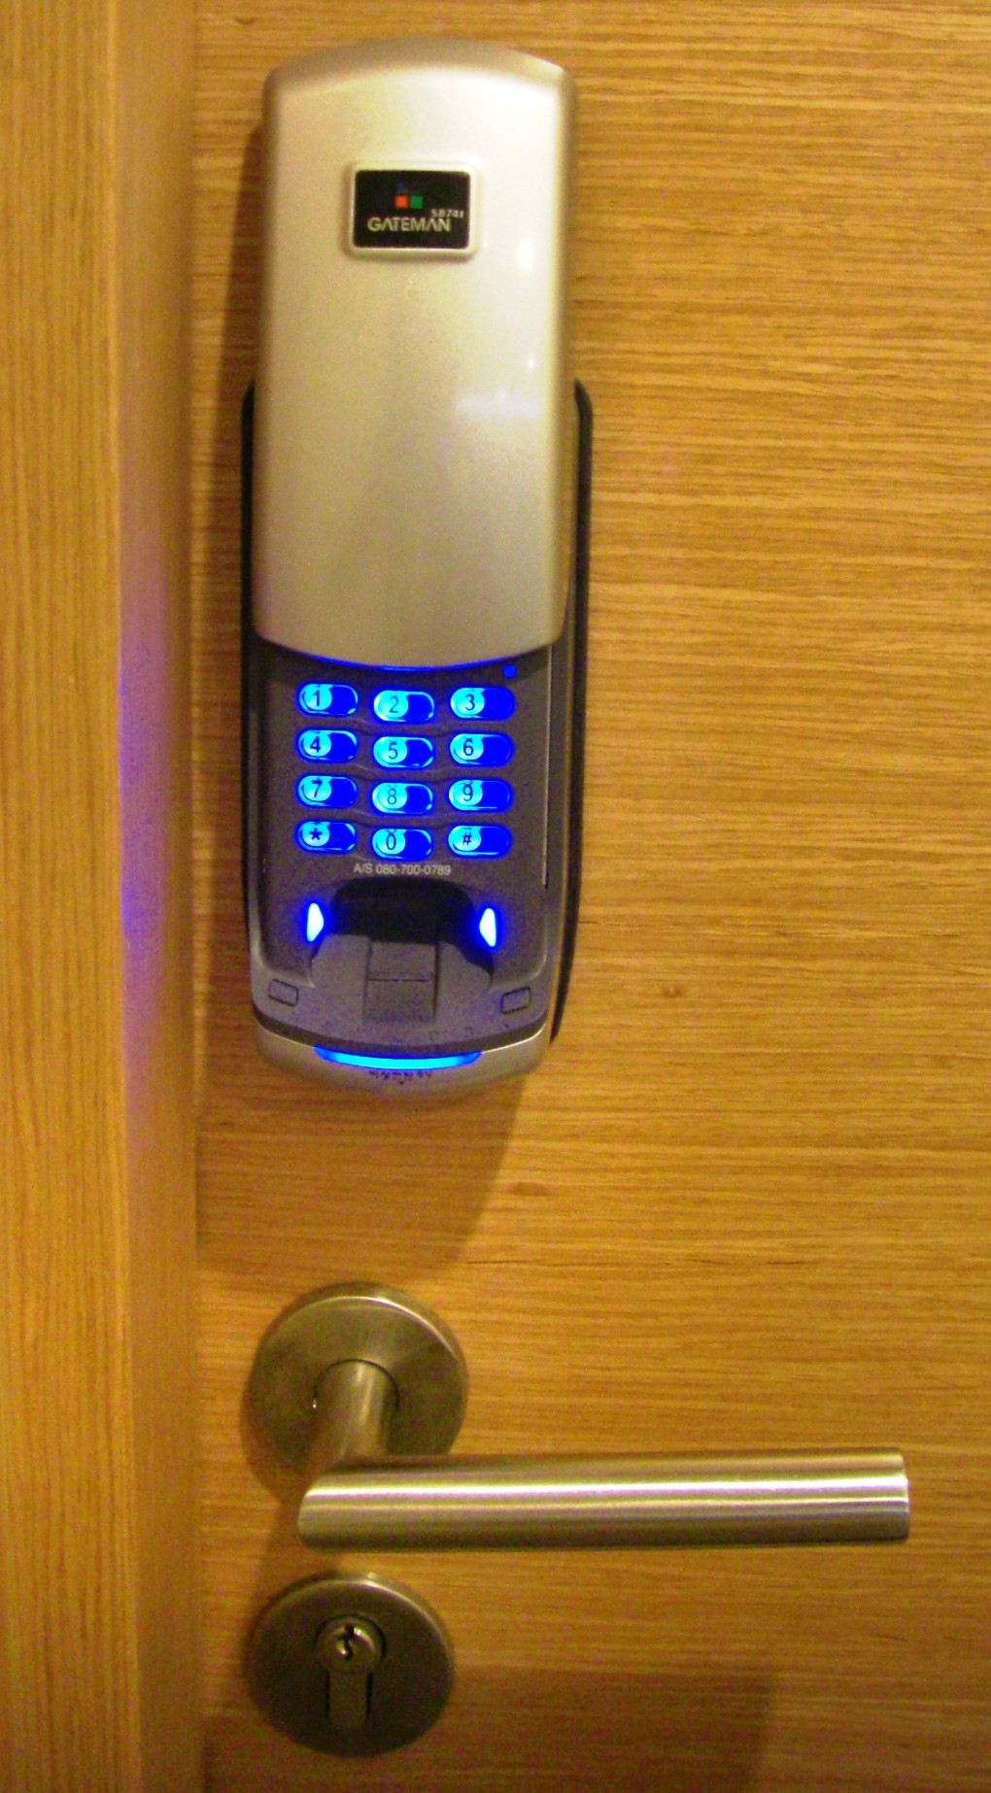
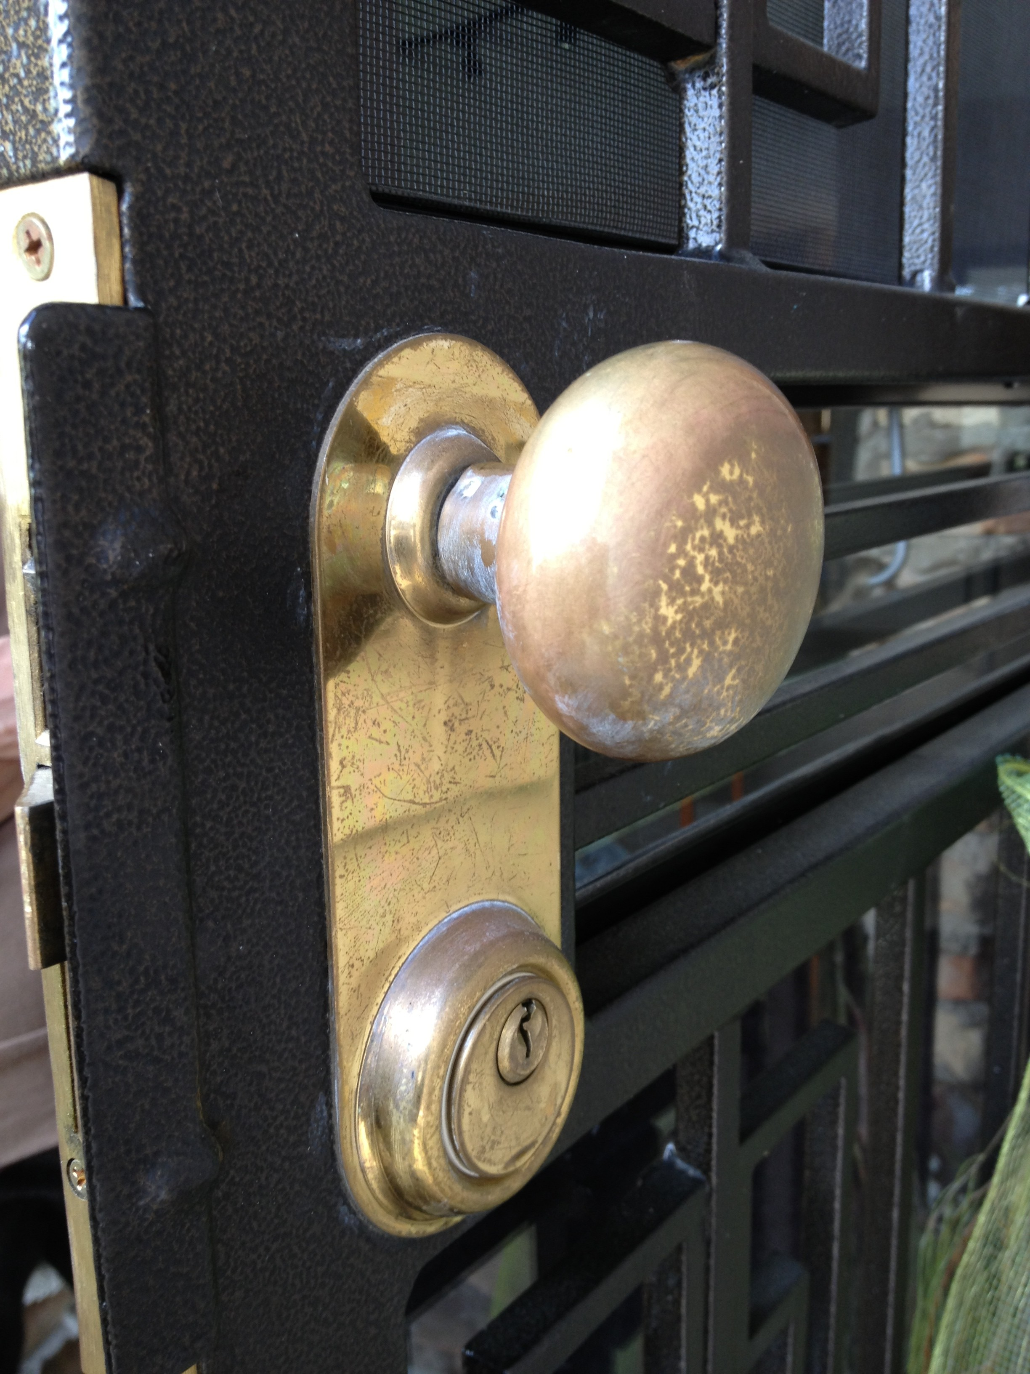
Examples:
Locks
Biometric,
Electronic
Lock
Mechanical
Lock
Sources: Wikimedia Commons (Ronhjones, Sekuloff)
9

Slide 10
Mantraps
• Enclosures with different entry, exit points
• Person enters mantrap, requests access
– If verified, allowed to exit mantrap into facility
– Otherwise, denied entry: person can only exit
when
security
official
overrides
mantrap
locks
10

Slide 11
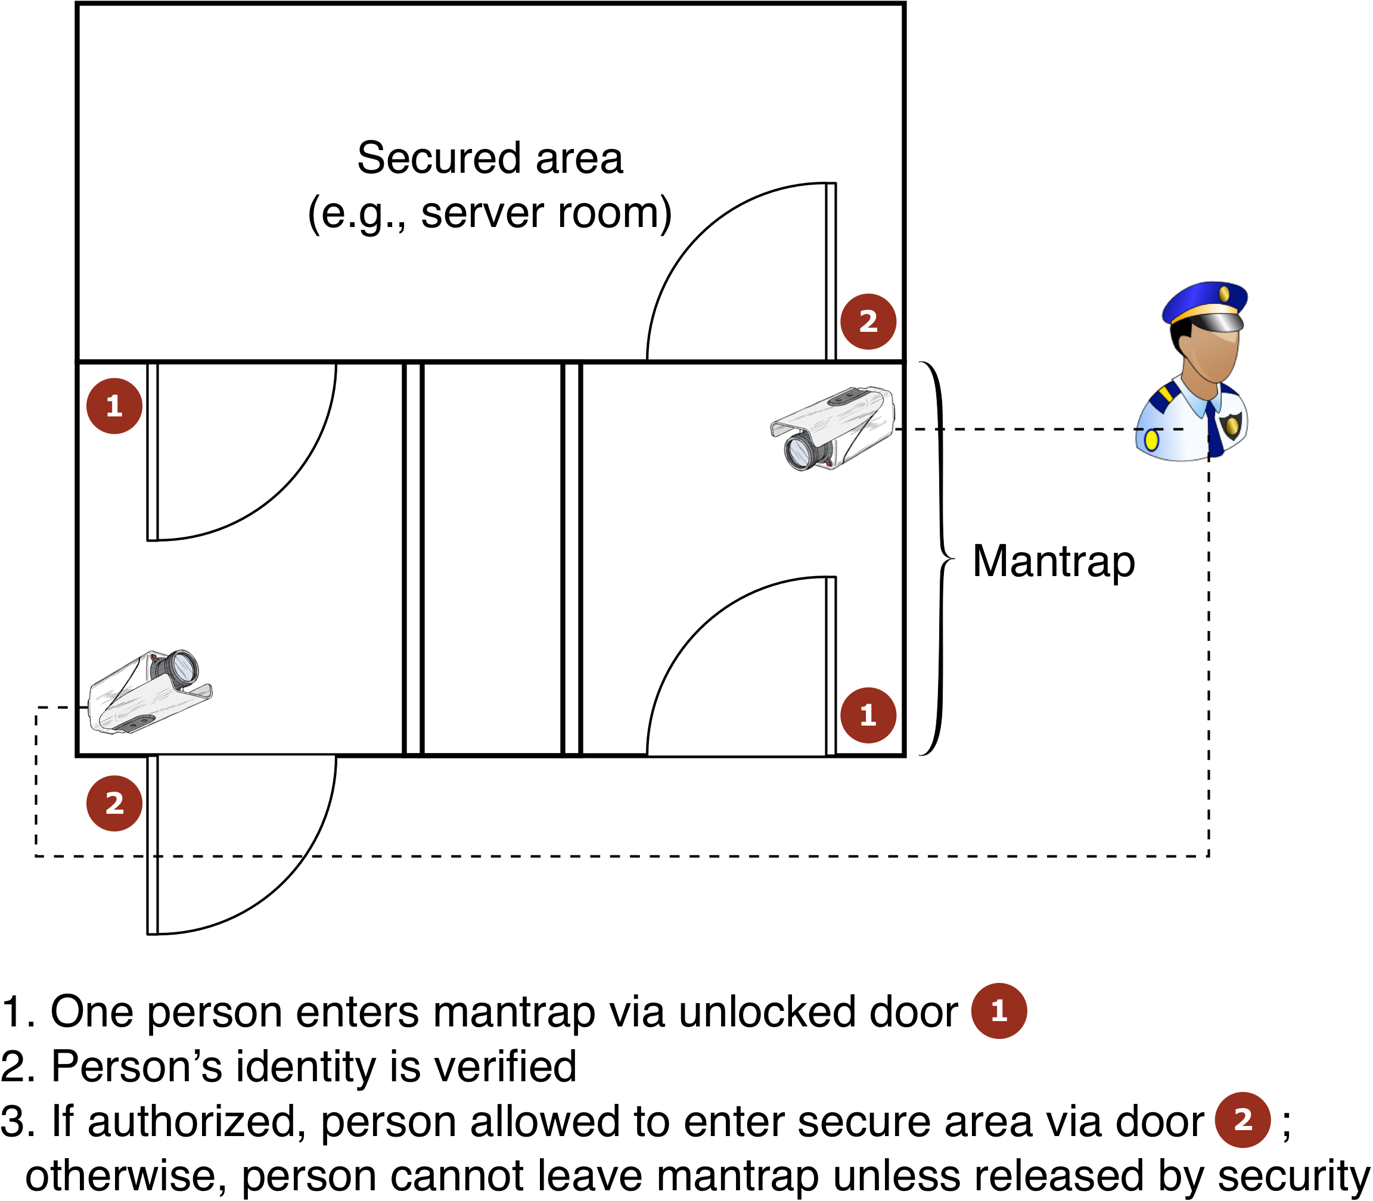
Example
Mantrap
11

Slide 12
Electronic
Monitoring
• Records events where other types of physical
controls are impractical
• May use cameras with video recorders
• Drawbacks:
– Reactive; does not prevent access
property damage)
– Recordings often not monitored in be reviewed to have any value
– Video is data-intensive!
to facility
(or
real time, must
12

Slide 13
Alarms
and Alarm
Systems
• Alarm systems notify when “events” occur
Use cases: fire alarms, environment disturbances, service interruption
• Systems
– Motion
– Smoke
rely on sensors
detectors detectors
for
event
detection:
– Thermal detectors
– Glass breakage detectors
– Weight/contact sensors
13

Slide 14
Computer
Rooms
and
Wiring Closets
• Extra attention required for these areas
Controls easily defeated if attacker gets physical access to computing equipment
• Custodial staff may be concern
– Low scrutiny, supervision
(security)
– High degree of access to
offices
14

Slide 15
Interior
Walls
and
Doors
• Typical types of walls in facility:
– Standard interior
– Firewall
• High-security areas need physical
firewalls to
resist
intruders, increases building resistance to fire
• Evaluate doors to secured rooms too
Consider installing push/crash bars for computer rooms, wiring closets
• Meets building codes
• Provides higher levels of security than standard door handles
15
Notes:
Difference between physical firewall and software firewall

Slide 16
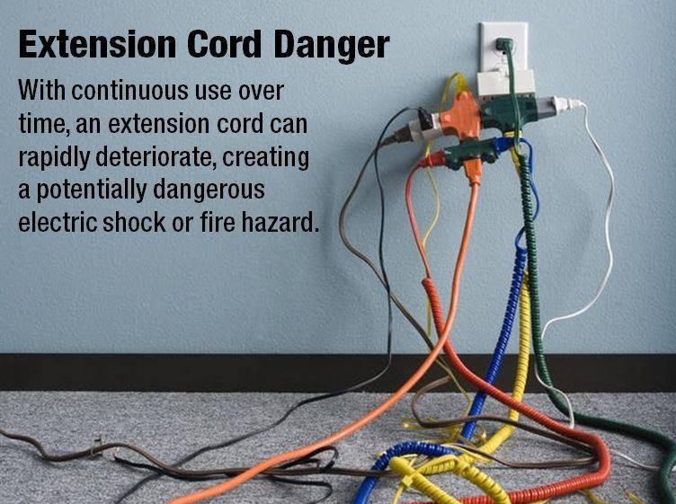
Fire
Fire: most serious threat to safety of people in org.
– Cause more property damage, personal injury, and death than any other threat
– Necessitates fire detection, response measures in physical security plans
Safety
How NOT
to use extension cords
Source: https://twitter.com/Smart911/status/678641207006883840
16

Slide 17
Fire
Detection
and
Response
• Fire suppression systems: devices that detect
fire, respond accordingly
• Systems deprive fires of what they need to burn:
heat, fuel, oxygen
– Water (mist) systems: reduce temperature, saturate
some fuels to prevent ignition
– Carbon dioxide systems: deprive fire of oxygen
– Soda acid systems block fire fuel, preventing spread
– Gas-based systems: block combustion but leave
enough oxygen for people to survive short time
17

Slide 18
Fire
Detection
• Fire detection is precondition for fire suppression
Fire detection systems have two categories: manual,
automatic
Fire safety entails people monitoring fire evacuation
to prevent attacker entering offices
Three main types of fire detection systems: thermal
detection, smoke detection, and flame detection
– Smoke detectors operate in one of three ways:
photoelectric, ionization, and air-aspirating
18
Notes:
Difference between flame and smoke

Slide 19
Fire
Suppression
• Can be portable, manual, or automatic
• Portable extinguishers are rated by type
of fire:
– Class
– Class
– Class
– Class
A:
B:
C:
D:
fires
fires
fires
fires
of ordinary combustible fuels
fueled by combustible liquids, gases
with energized electrical equipment
fueled by combustible metals
• Installed systems spray liquid, gas for fire
suppression
– Sprinkler systems spray liquid (water)
– Sprinkler system options: wet-pipe, dry-pipe, pre-action
– Water mist sprinklers use fine mist to extinguish fires
19

Slide 20
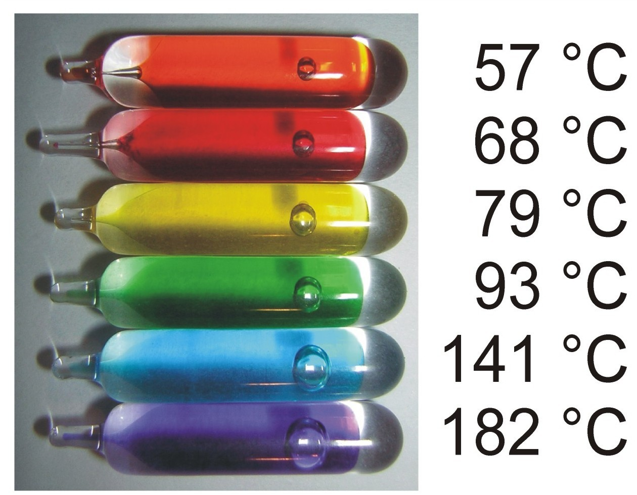
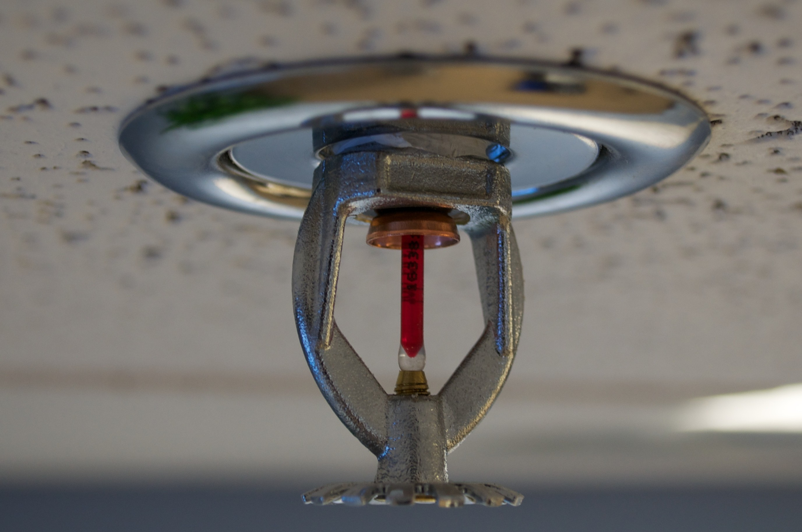
Example:
Fire
Sprinkler
System
Source: Wikimedia Commons (David40226543/Micha0001,
Brandon Leon)
20

Slide 21
Gaseous
Emission
Systems
• Until recently there were only two types of
systems: carbon dioxide, halon
– Carbon dioxide deprives fire of oxygen
– Halon: “clean agent” that
installations prohibited
• Alternative clean agents
– FM-200
– Inergen
– Carbon dioxide
– FE-13 (trifluromethane)
depletes ozone
layer;
new
include:
21

Slide 22
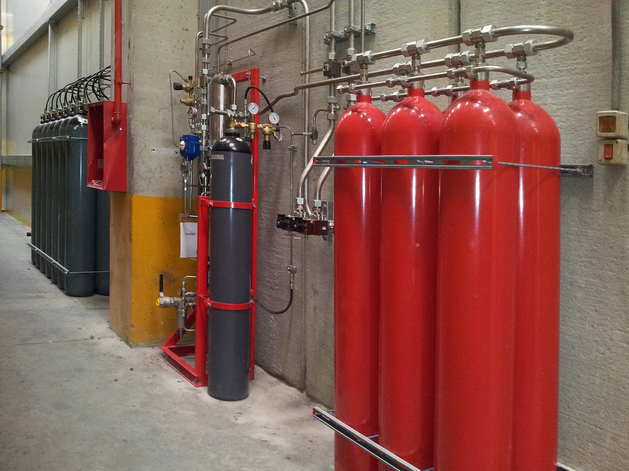
Example:
Gaseous
Fire
Suppression
Source: Flickr (Seeweb, CC-BY-SA 2.0)

Slide 23
Failure
of
Supporting
Utilities
and
Structural
Collapse
• Supporting utilities include heating, ventilation,
and air conditioning (HVAC); electricity; water;
sewage; garbage disposal
– Utility failure obviously affects building safety
– Interruption of services may lead to vulnerability injection in systems designed to protect info.
23

Slide 24
Heating, Ventilation, and Air
Conditioning (HVAC)
• How can HVAC systems damage info. systems?
– Extreme temperature
• Most computers work between 70–75 ℉ (22–24
℃)
• Comfortable temperatures for people
– Filtration
– Humidity
– Static electricity
too ☺
• Damages sensitive circuitry, including computers
• Person can generate up to 12,000 V walking on carpet!
24

Slide 25
Ventilation
Shafts
• Security of the ventilation ductwork:
– Ducts in commercial buildings could be enough for person to climb through
large
– Security can
install wire mesh
grids
for
large
grids
to
split
up
the
ducts
25

Slide 26
Power
Management
and Conditioning
• Concerns include electrical quantity (voltage,
amperage); power quality (cleanliness, installation)
Noise interfering with 60-Hz alternating current can
yield inaccuracy in CPU clocks
• Electrical grounding:
– Ensures that returning current is discharged to ground
– Improper installation can damage equipment, injure people
Overloading circuits can cause problems with circuit
breakers and overload electrical cables
• Risk of electrical fire
26

Slide 27
Uninterruptible Power Supplies (UPSs) (1)
• In case of power outage,
backup power source for
• Four basic configurations
– Standby UPS
UPS provides
computer
systems
of
UPS:
– Ferroresonant standby
– Line-interactive UPS
– True online UPS
UPS
27

Slide 28
Uninterruptible
Power
Supplies
(UPSs)
(2)
• Standby UPS: offline battery backup that detects
power interruptions
Ferroresonant standby UPS: offline UPS whose
transformer reduces power problems
• Line-interactive UPS: always connected to output
• Faster response time; conditions power, filters noise
• True online UPS: primary power source is battery
• A/C-power from utility recharges batteries
– Provides constant power to computers without power
quality problems
28

Slide 29
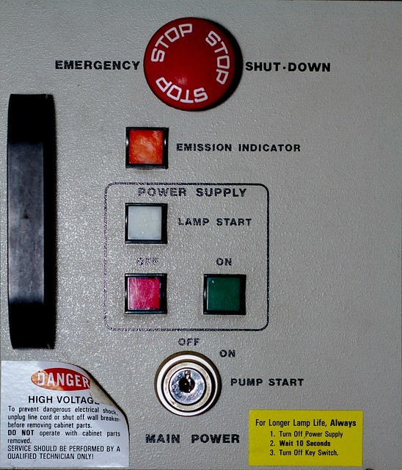
Emergency
Key requirement: shut
off power at once if
current poses risk to
machines, people
Most computer rooms have emergency
Shutoff
power shutoff red button”)
(“big
Source: Flickr (Dennis van Zuijlekom,
CC-BY-SA 2.0)
29

Slide 30
Electrical
Terms
Term Definition
Fault Momentary power interruption
Blackout Prolonged power interruption
Sag Momentary drop in power voltage levels
Brownout Prolonged drop in power voltage levels
Spike Momentary increase in power voltage levels
Surge Prolonged increase in power voltage levels
30

Slide 31
Water
Problems
• Lack of water poses problems to
– Fire suppression systems
– Water chillers for air conditioning
• Too much water (pressure): real
systems
threat
• Hence, we need to integrate water
detection systems with alarms used monitor buildings
to
31

Slide 32
Structural
Collapse
• Structures housing an org. can fail due to
environmental factors, forces of nature
• Structures designed with load limits
– Overloading load limits results in structural
failure, possibly injury or death
– To prevent this, civil engineers should inspect buildings, identify dangers before failure
32

Slide 33
Testing
Facility
Systems
• Physical security of a facility must be
constantly documented and tested
Documentation of facility configuration,
integrated into disaster recovery plans and
operating procedures
Testing provides necessary info. to improve facility security, find weak points
33

Slide 34
Interception
of
Data
• Three methods of data interception:
– Direct observation
– Data transmission
– Eavesdropping on signals
• All electronics emit electromagnetic signals;
on computer can be reconstructed
data
• TEMPEST (NSA): technology control to prevent it
Side-channel attacks: monitor keystroke acoustics, screen displays, etc.
34

Slide 35
Mobile
and
Portable
Systems
• Mobile devices, laptops pose threat to
information security
– Devices may have (sensitive) org. info on them
– Devices may be configured to access org.’s secure computing facilities
– Not
to
mention
ease
of
theft
(mobile
devices)
35

Slide 36
Stopping
Laptop Losses
• Controls support security and retrieval of lost
or stolen laptops
– CompuTrace: installed on laptop hardware, reports
to a central monitoring location
– Burglar alarms (PC card with motion detector):
If laptop alarm is armed and laptop is moved beyond a certain distance, audible alarm triggers
The system shuts down the computer and includes an encryption option for info. on laptop
– BitLocker (Windows Vista+), FileVault (OS X), home directory encryption (Linux)

Slide 37
Remote
Computing
Security
• Remote site computing:
Telecommuting: remote networking technology
Employees may need to business trips
distant from org. facility
computing using
access org. networks
on
• Remote workers need access from home
systems or satellite offices
External connections, systems need security support these use cases (e.g., VPN)
to
37

Slide 38
Special
Considerations
for
Physical
Security
Threats
• Develop physical security in-house or outsource?
– Many qualified and professional agencies
– Benefit of outsourcing: gain experience, knowledge
these agencies
– Downsides: high expense, loss of control over the individual components, and level of trust placed in another company
of
• Social engineering: using people skills to obtain
information from employees
– For more info see Kevin Mitnick’s The Art of Deception
38

Slide 39
Inventory
Management
• Computing equipment should be inventoried,
inspected on regular basis
Classified information should also be inventoried and managed
– Whenever classified document is copied, place stamp on it (with security level, document number)
– Each classified copy sent to the receiver, who signs for the document
– Electronic example: DocuSign, similar services
39

Slide 40
Summary
Physical security complements info. security – it’s
just as important!
– Controls include locks, keys, ID badges, etc.
– Monitoring, intrusion detection via alarms, electronic
systems
– Utilities mgmt. (electrical, etc.), structural integrity
– Fire detection/suppression are crucial
– Data loss prevention and secure remote computing
– Laptop/mobile device inventory, mgmt., security

Slide 41
Reference
[1] Class note by Adam C. Champion, Ph.D.

